Slide 1
Group Assignment 4: Prediction Competition
Paige Steffan, Spencer Wood, Sydney Johnston, Rose Civitts

Slide 2
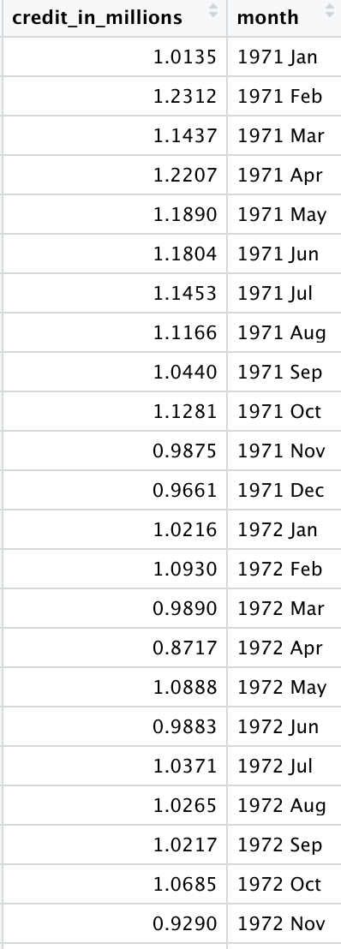
Data Preparation
To prepare the data we split it into the holdout and training groups
credit_ts <- credit_ts %>%filter(year(month) >= '1970 Feb')
TrainingCredit <- credit_ts %>% filter(year(month) <= '2004 Jan')
In our graph you can see the first snippet of the training group we have used.
We made the training group to be anything less than or in January 2004 and the hold out to be anything earlier than that.
Splitting the data allows us to have accurate models that are relevant to the data we collect in the future.
After creating these groups, we were able to analyze our data.

Slide 3
Adding Time Series Component
In order for the credits data to be valid for time series analysis, a time component must be added.
We know the credit data was collected on a monthly basis and are making the assumption that data was collected each month (no skipped months) and the months were sequential.
credit$month <- 492:1
credit$month <- yearmonth(credit$month)
This code was used to assign sequential months to the data. Since the data is sequential by month, the year chosen is not important in forecasting or analysis.

Slide 4
Naive Model
Forecasting where the last periods sales are used for the next forecast without predictions or adjusting factors
Uses current value or mean for next forecast
For the most part, this economically works very well.

Slide 5
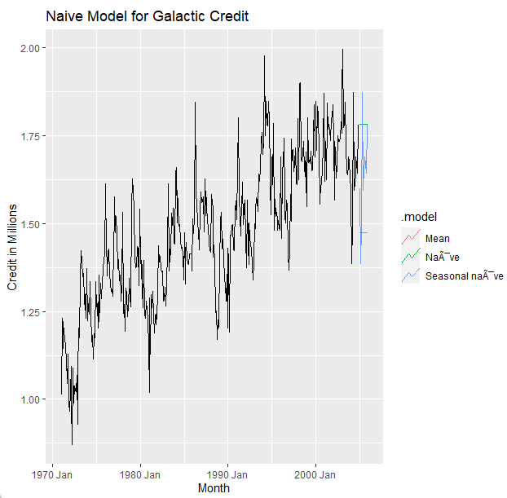
Naive Model Interpretation
In our case, it looks as if only the seasonal naive credits will be close to last months.
Since the mean method and the naive method do not follow the trend, we can say that the seasonal naive model is best here.

Slide 6
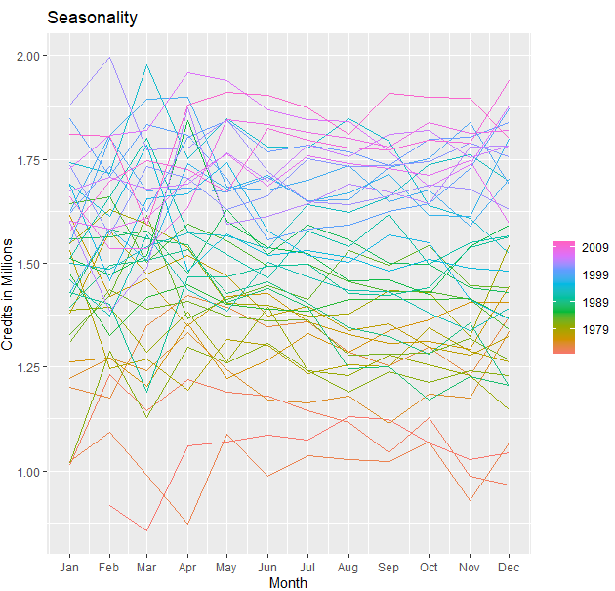
Credits Seasonal Plot

Slide 7
Seasonal Plot Interpretation
It is hard to pick out the seasonality in the data from this graph, but one thing to notice is that most years seem to drop low in February and March, rise rapidly in April and May, then slowly decline through the rest of the year.
The randomness of the data stands out in this graph, and is also important in our next graph, the decomposition of the data.

Slide 8
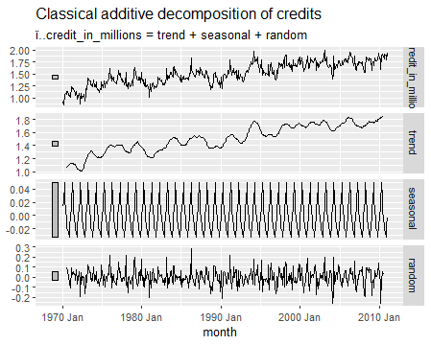
Classical Additive Decomposition

Slide 9
Decomposition Model Breakdown
The decomposition of the data set shows that the trend has the largest impact on the data, shown by it having the smallest bar on the scale to the far left of the graphs.
Seasonality is shown to have a much weaker impact on the data because the scale on the left is drastically larger than the rest.
The random “white noise” of the data has more of an impact on the data than the seasonality, which is not great. Ideally the data would not be as random so that our forecasting power would be greater.

Slide 10
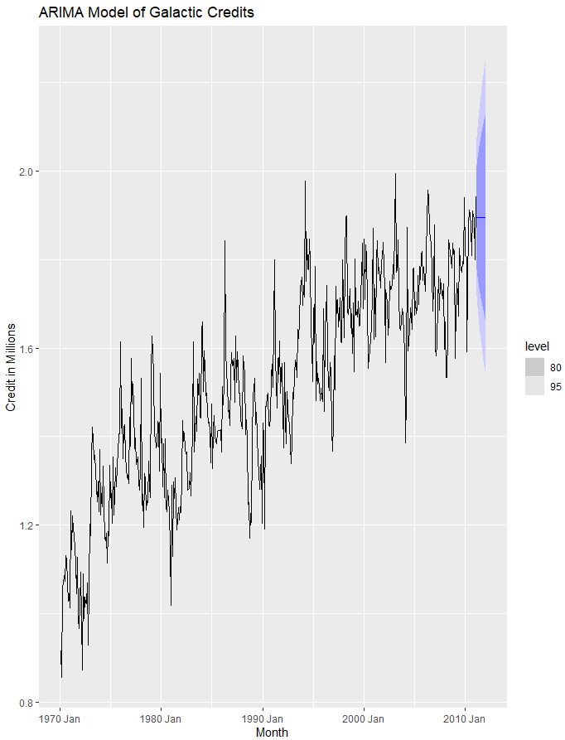
ARIMA Model

Slide 11
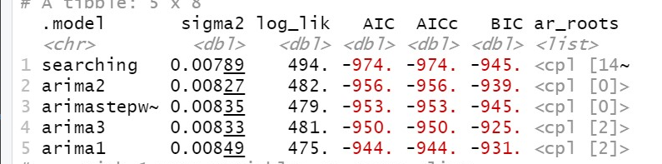
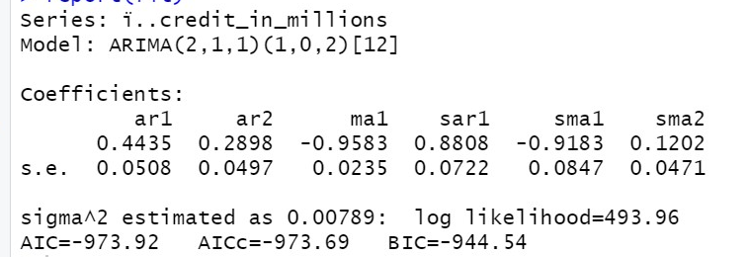
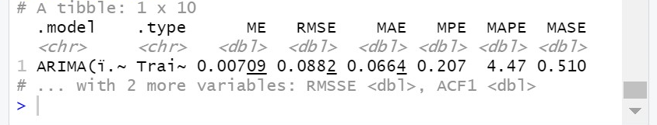
ARIMA Model Interpretation
ARIMA stands for “autoregressive integrated moving average”. In simpler terms, it uses past data to predict future data for a time series.
Five ARIMA models were used to find the
best model for the series. The best fit
is the searching ARIMA
The AICc is -973.69 and the
RMSE is .0882

Slide 12
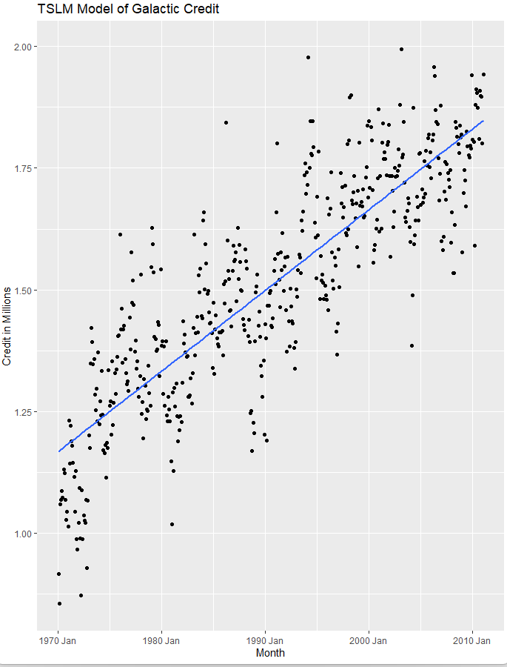
TSLM Model

Slide 13
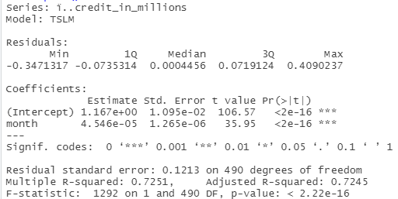
TSLM Interpretation
TSLM fits linear models to a time series and incorporates seasonality and trend data.
The fitted line for the model created has a positive slope. This indicates a positive relationship between time and credits.
As 1 month increases in time results in a 0.00045 increase in credit (in millions).
Time and Credits in millions are indicated to have a statistically significant relationship.

Slide 14
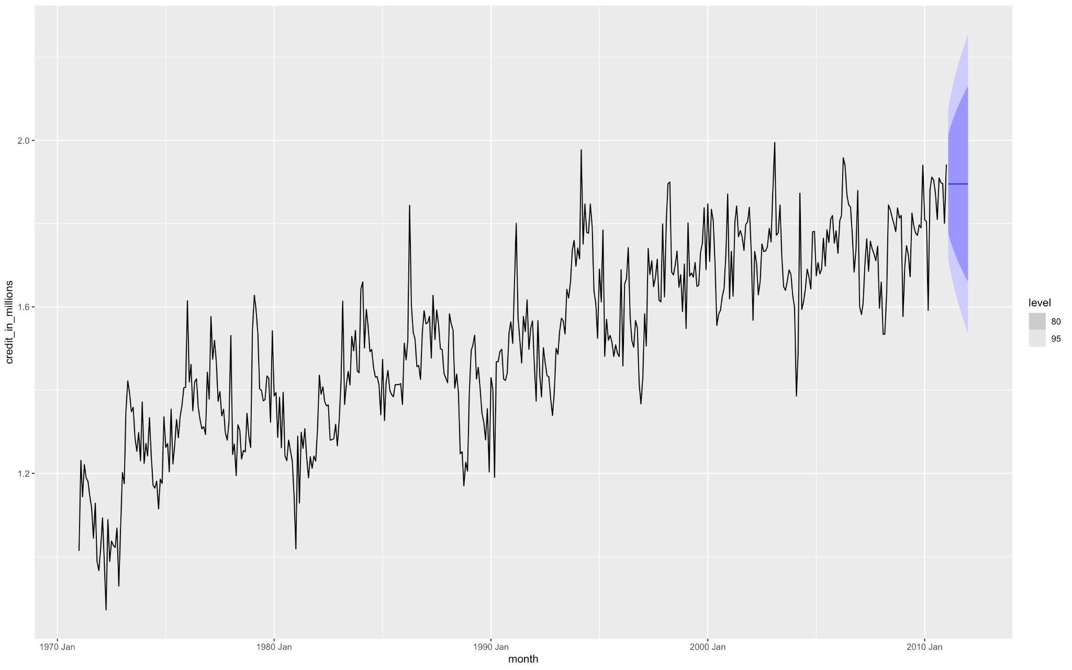
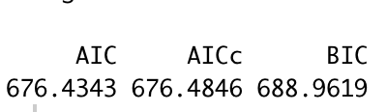
Exponential Smoothing
Model
Due to the low parameter you can see the trend here is staying steady.
To be able to see if this is a useful ETS model, we would have to compare it to another ETS model.

Slide 15

RMSE of our Models
Naive Model
Exponential Smoothing Model
TSLM Model
ARIMA Model

Slide 16
Best Fit Model and Conclusion
We compared the models using the RMSE
RMSE is the root mean squared error and this is just a fancy way of saying average distance between the predicted values from the model and the actual values in the dataset.
Therefore the smaller the RMSE the better fit and more accurate the model will be.
That is why we found Arima to be our best fit model, that is because we running all of the RMSEs this was the smallest.
Our smallest RMSE was 0.0892

